Slide 1

딥러닝 (Deep Learning)
Homework 9
Self-supervised Learning for NLP

Slide 2

Programming assignments
Deep Learning Basic MLP
Object Recognition ResNet
Face Recognition Free choice model
NLU CNN for Sentence Classification
Object Detection YOLO
Image Generation GAN, CGAN, DCGAN
NLG LSTM
SSL for Computer Vision ViT
SSL for NLP BERT
LLM ChatGPT

Slide 3
Assignment 9: BERT for text classification
[Dataset]
SearchCreativeWork (e.g. Find me the I, Robot television show),
GetWeather (e.g. Is it windy in Boston, MA right now?),
BookRestaurant (e.g. I want to book a highly rated restaurant in Paris tomorrow night),
PlayMusic (e.g. Play the last track from Beyoncé off Spotify),
AddToPlaylist (e.g. Add Diamonds to my roadtrip playlist),
RateBook (e.g. Give 6 stars to Of Mice and Men),
SearchScreeningEvent (e.g. Check the showtimes for Wonder Woman in Paris).
The training set contains of 13,084 utterances, the validation set and the test set contain 700 utterances each, with 100 queries per intent.
Data | Description | Target Class
MR (Pang and Lee, 2005) | Movie reviews | 2
SNIPS (https://paperswithcode.com/dataset/snips) | Classifying a queries into 7 user intents | 7

Slide 4
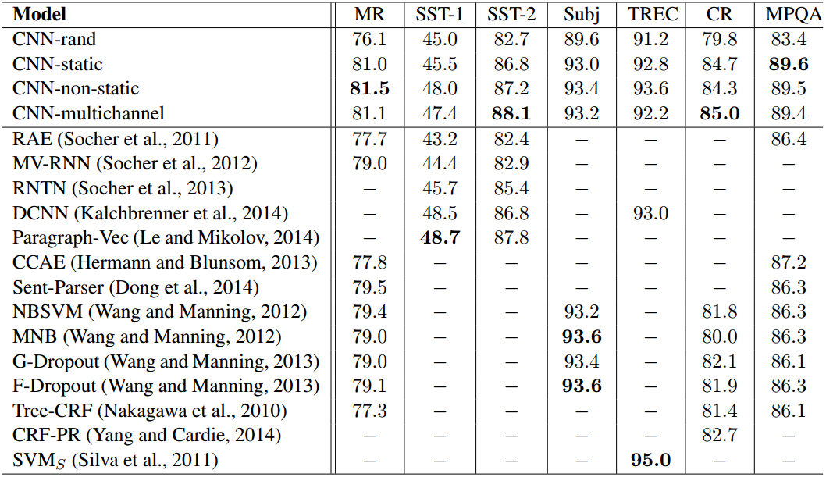
Assignment 9: BERT for text classification

Slide 5
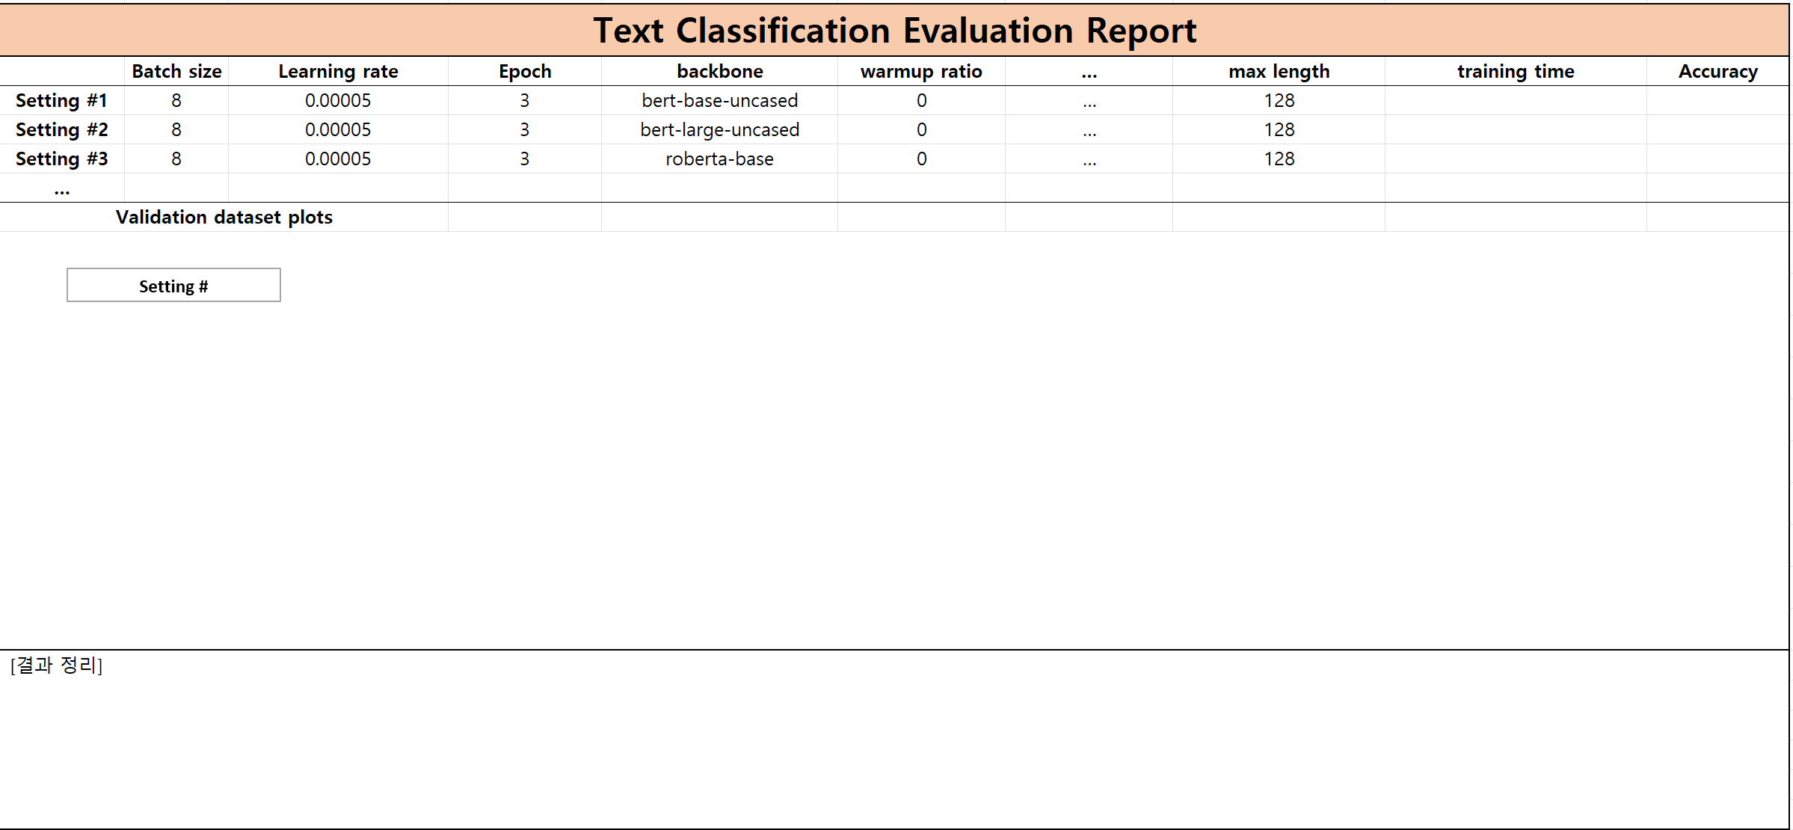
Assignment 9: BERT for text classification
[Evaluation report]

Slide 6
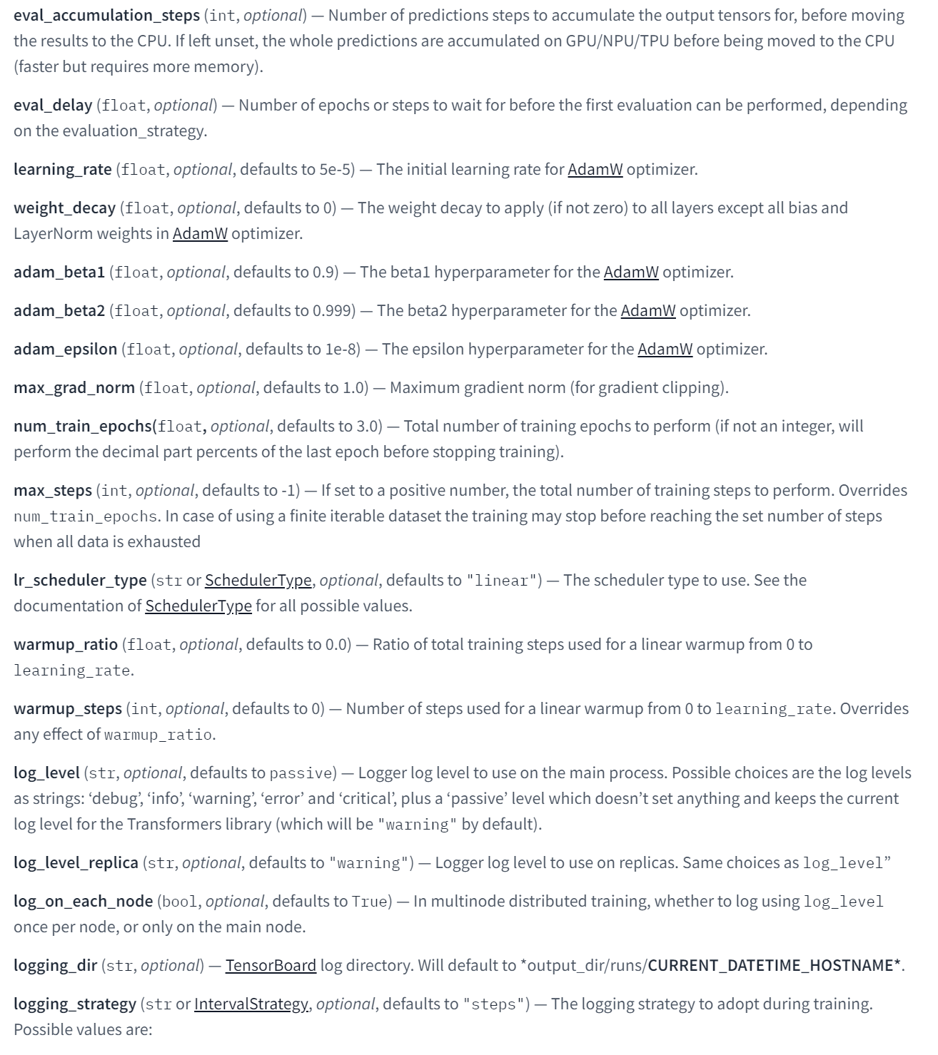
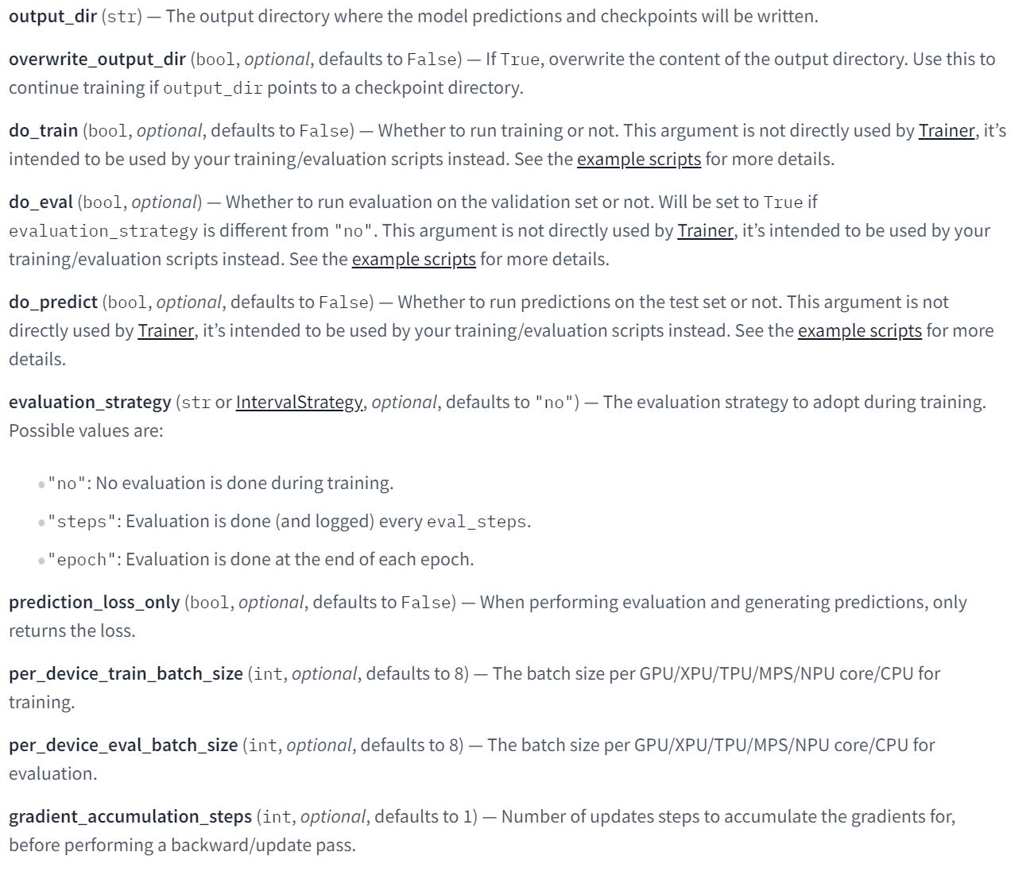
* training_args
https://huggingface.co/docs/transformers/main_classes/trainer
https://huggingface.co/datasets
https://huggingface.co/models

Slide 7
Assignment 9: BERT for text classification
Evaluation Criteria
Simplicity | How concisely did you write the code? 배점 2점 MR 데이터 전처리: 2점
Performance | How well did the results of the code perform? - 배점 3점 Test set accuracy 기준 87.5 이상 달성: 2점 One review sentence inference: 1점

Slide 8
Assignment 9: BERT for text classification
Due to : ~ 6/13 (Fri) 23:59:59
Submission : Online submission on cybercampus
Your submission should include
The whole code of your implementation
The evaluation report
You must implement the components yourself!
File name : StudentID_Name_HW9.zip

Slide 9
Q&A

